Slide 1
Virtual Machine Automation
Parthkumar Barot (C0695511)
Harsh Patel (C0693162)

Slide 2
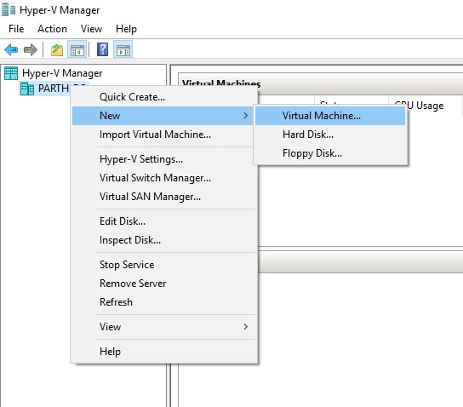
Creating Virtual Machine In Hyper-V

Slide 3
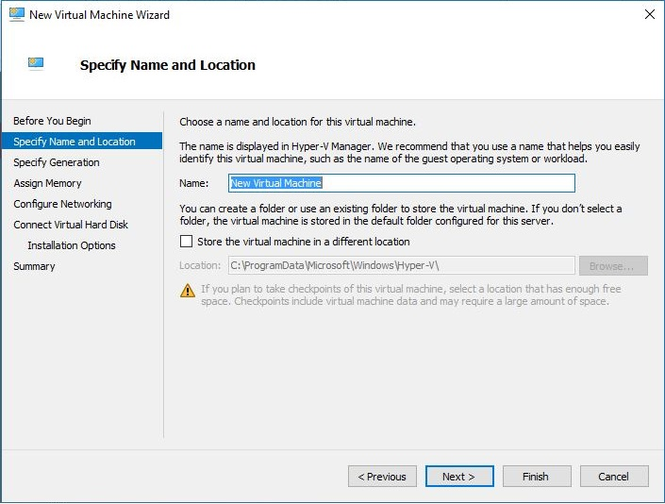
Creating Virtual Machine In Hyper-V

Slide 4
Creating Virtual Machine In Hyper-V
Specify Name and Location
Specify Generation
Assign Memory
Configure Networking
Connect Virtual Hard Disk
Installation Options

Slide 5
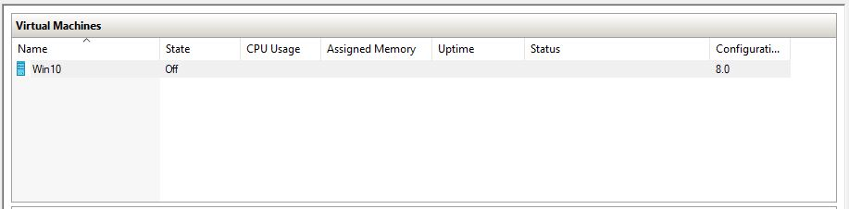
Creating Virtual Machine In Hyper-V

Slide 6
Why Automation?
There are millions of cloud users, to provide better and faster service to them automation is needed. It is not possible to deploy Virtual machine manually every time when a new user wants some space over cloud, Automation makes it simpler and easier.
To reduce deployment errors, we need automation as if it has human interaction, then it may have deployment error.
It reduces costs and increases user acceptance.

Slide 7
Automation with user interface This application is about…
By using this application we can make virtual machine by just providing the requirement.
Application parameters
Size of RAM
Size of
Virtual Hard Disk
Operating System

Slide 8
Automation with user interface
Microsoft Technology
Microsoft has wide range of development tools
Developer friendly
Hyper-V, PowerShell Script and C# are being used in application

Slide 9
Why PowerShell Script?
Developed by Microsoft.
based on the .NET framework
To simplify and automate tedious and repetitive tasks by creating scripts and combining multiple commands together.

Slide 10
Automation
This application includes 3 GUI screens
Screen to create a virtual machine
Screen to update configuration to virtual machine
Screen to remove virtual machine
Kind of administrative use

Slide 11
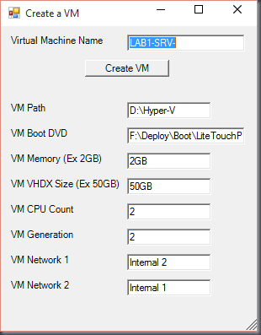
Automation
Screen to create a virtual machine
By using this module we can make virtual machine.
We need to provide the required parameters.
This form shows us a example of GUI screen

